Slide 1
SpotifyU
By Shawn, Kyle, Angela & Fatih

Slide 2
About Us
Shawn
2nd year
CS/ITWS Dual Major
Westchester, NY
Orhan
2nd year
CS Major
Istanbul, Turkey
Kyle
3rd year
ITWS/Psychological Science Dual Major
Simsbury, CT
Angela
3rd year
ITWS/Psychological Science Dual Major
Sarasota, FL

Slide 3
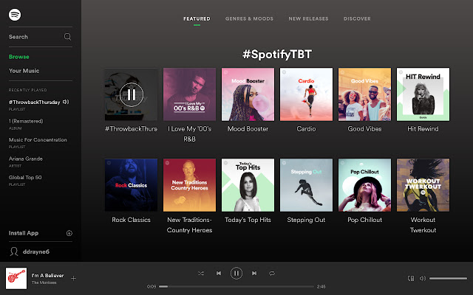
Introduction
Spotify has more than 400 million users and currently holds more than 80 million tracks, and we wanted to create an app that these users can benefit.
We proposed an app that displays the user statistics and recommendations.

Slide 4
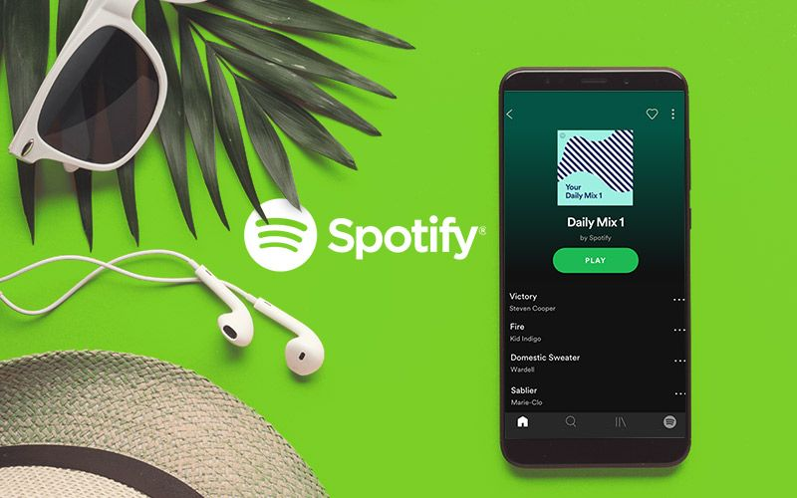
Our Project Proposal
Our proposed project is a Spotify web app that would use the Spotify user's data directly from their account through the use of an application programming interface (API)
We would use it to provide the user with statistics on their current listening history and recommend new genres, songs, and artists that they might enjoy for the future.

Slide 5
Timeline
September: Project Introduction, working on specific ideas and our project proposal
October: Deciding on our project and beginning front-end implementation for midterm report
November: After our midterm presentation we began implementation of back-end, mainly consisted of SpotifyU, spent much of thanksgiving break working on API functionality
December: Finished implementing the API into our website and cleaned up styling and overall page after recommendations

Slide 6
Services
Recently Played
Displays the song name, artists, and the exact time the song began playing
Top Tracks
Displays the songs you listen to the most by the selected time frame
Recommendations
Displays recommended songs based on favorite artists and tracks

Slide 7
Tech Stack
HTML and CSS3
Create interactive, visual appealing, accessible page
Frontend
Javascript
Change the content dynamically
Account dropdown menu
Created functions to make API calls
PHP
To interact with database and server -> data up-to-date
Because friends’ data is not provided by the API, we decided to store only the login data of our users

Slide 8
Tech stack (cont’d)
MySQL/MariaDB
Database to store data of clients
Spotify Web API
Fetch client’s song preference data

Slide 9
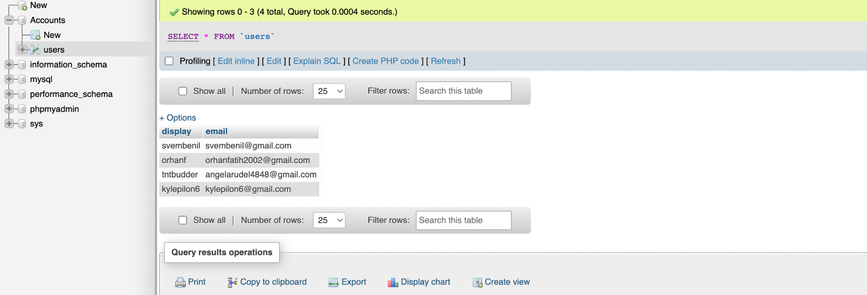
PHP
Used PHP to store login info

Slide 10
Spotify Web API
Provides a secure authorization flow to get end users’ Spotify Data
Uses OAuth 2.0
Each developer creates their application bound to their Spotify account and use their developer ID and secret to redirect the users to Spotify’s login.
After the user logs in, Spotify displays the scope of authentications the developer is requesting to the user.
If the user grants the permissions, they are redirected back to the application where their authorized token is given to the developer.
The token provided expires within an hour and needs to be refreshed using either the refresh token or another login.

Slide 11
What Spotify Web API Offers
With the token that has appropriate authentications, developer can access to Users:
Saved tracks
Profile data (Unfortunately, data for users’ followers is not provided and will not likely be provided soon by the API).
Top items (tracks or artists)
Followed artists
Playlists
Recently played tracks

Slide 12
Challenges We Faced
Majority of the challenges we faced were about the API such as
Figuring out how to follow correct authorization flow
Storing the token and using it over and over without asking user to log in again (we ended up using the local storage)
Getting the recommendations (The API does not provide recommendations based on users)

Slide 13
DEMONSTRATION

Slide 14
Thank you!
Questions?

